Slide 1
Functional Data Analysis

Slide 2
What are functional data?

Slide 3
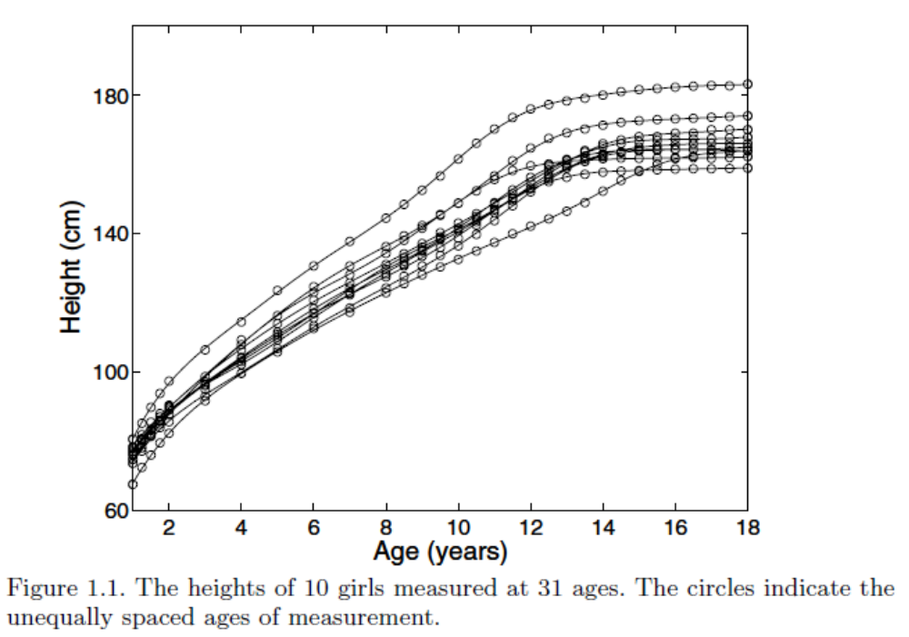
Samples of functional observations:
Data on the Growth of Girls

Slide 4
Data on the Growth of Girls
Heights of 10 girls measured at a set of 31 ages in the Berkeley Growth Study
The ages are not equally spaced; there are four measurements while the child is one year old, annual measurements from two to eight years, followed by heights measured biannually.

Slide 5
Data on the Growth of Girls
Although great care was taken in the measurement process, there is an average uncertainty in height values of at least three millimeters.
  Height diminishes throughout the day as the spine compresses, but it also depends on other factors.
  Infants must be measured lying down, and when the transition is made to measuring their standing height, measurements shrink by around one centimeter.
  The most careful procedures still exhibit standard deviations over repeated measurements of about three millimeters.

Slide 6
Data on the Growth of Girls
Even though each record is a finite set of numbers, their values reflect a smooth variation in height that could be assessed, in principle, as often as desired, and is therefore a height function.
Thus, the data consist of a sample of 10 functional observations which we can think of as H_{i}(t), i = 1, 2, ..., 10.
Although we commonly refer to data and curves such as shown in these figures as “growth curves,” the term growth really means change (in height).
  The height data only indirectly reflect growth, because they are measures of the consequences of growth.
Hence, it is the velocity function V (t), the instantaneous rate of change in height at time t, that is the real growth curve, and we should use the term “growth” to mean V (t).
Because height does not decrease (at least during the growing years), velocity or growth is necessarily positive.

Slide 7
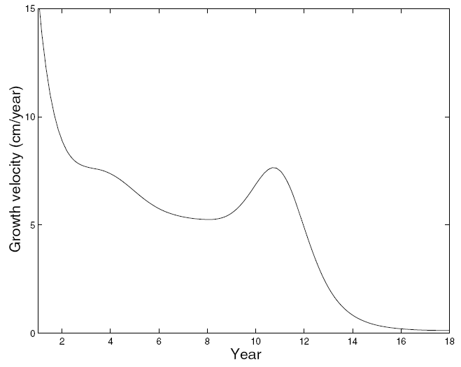
Data on the Growth of Girls

Slide 8
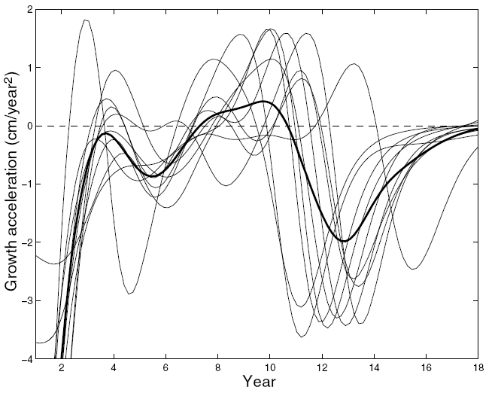
Data on the Growth of Girls
We can get more understanding of the growth process by studying the rate of change in velocity; this is the acceleration in height, denoted by A(t).

Slide 9
Data on the Growth of Girls
The pubertal growth spurt (PGS) shows up as a pulse of strong positive acceleration followed by sharp negative deceleration.
  Naturally there is a big positive surge in velocity at the beginning of the PGS, followed by a return to zero when the velocity is no longer increasing, and finally a negative change in velocity in the final phase.
  It can be seen that the timing of the pubertal growth spurt varies a great deal from one girl to another.
But most records also show a bump at around six years that is termed the mid-spurt.
We therefore conclude that some of the variation from curve to curve can be explained at the level of certain derivatives.

Slide 10
Data on the Growth of Girls
The fact that derivatives are of interest is further reason to think of the records as functions, rather than vectors of observations in discrete time.
The ages themselves must also play an explicit role in our analysis, because they are not equally spaced.
Although it might be mildly interesting to correlate heights at ages 9, 10 and 10.5, this would not take account of the fact that we expect the correlation for two ages separated by only half a year to be higher than that for a separation of one year.

Slide 11
Data on the Growth of Girls
Although in this particular example the ages at which the observations are taken are nominally the same for each girl, there is no real need for this to be so.
In general, the points at which the functions are observed may vary from one record to another.

Slide 12
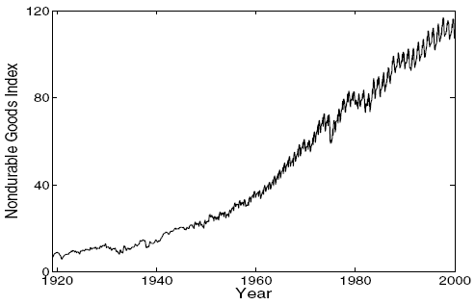
A single long multilayered functional observation:
US nondurable goods manufacturing index

Slide 13
US nondurable goods manufacturing index
Not all functional data involve independent replications;
  we often have to work with a single long record
Data like these often show variation as multiple levels.
There is a tendency for the index to show geometric or exponential increase over the whole century.
But at a finer scale, we see departures from this trend due to the depression, World War II, the end of the Vietnam War and other more localized events.
Moreover, at an even finer scale, there is a marked annual variation, and we can wonder whether this seasonal trend itself shows some longer term changes.
Although there are no independent replications here, there is still a lot of repetition of information that we can exploit to obtain stable estimates of interesting curve features.

Slide 14
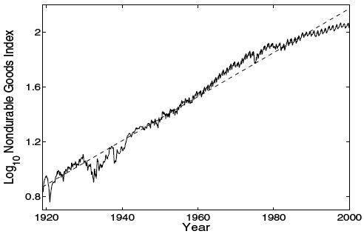
US nondurable goods manufacturing index
Plotting the logarithm of the data makes the trend appear linear while giving us a better picture of other types of variation

Slide 15
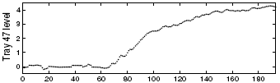
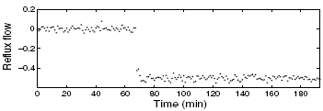
Input/Output Data for an Oil Refinery
The amount of a petroleum product at a certain level in a distillation column or cracking tower
reacts to the change in the flow of vapor into the tray at that level.

Slide 16
Input/Output Data for an Oil Refinery
How can we characterize this dependency?
More generally, what tools can we devise that will show how a system responds to changes in critical input functions as well as other covariates?

Slide 17
Multivariate Functional Data

Slide 18
Data on Handwriting
Multivariate functional data often arise from tracking the movements of points through space
> plot(handwrit[, 1, 1], handwrit[, 1, 2], type="l")
X-Y coordinates of 20 samples of handwriting
> for(i in 2:20) { lines(handwrit[,i,1],handwrit[,i,2])
}

Slide 19
Data on Handwriting
The role of time is lost in plots such as these, but can be recovered to some extent by plotting points at regular time intervals.
> plot.ts(handwrit[,1,])

Slide 20
Data on How Children Walk
The Motion Analysis Laboratory at Children’s Hospital, San Diego, CA, collected data which consist of the angles formed by the hip and knee of each of 39 children over each child’s gait cycle.
Time is measured in terms of the individual gait cycle, which we have translated into values of t in [0,1].
The cycle begins and ends at the point where the heel of the limb under observation strikes the ground.

Slide 21
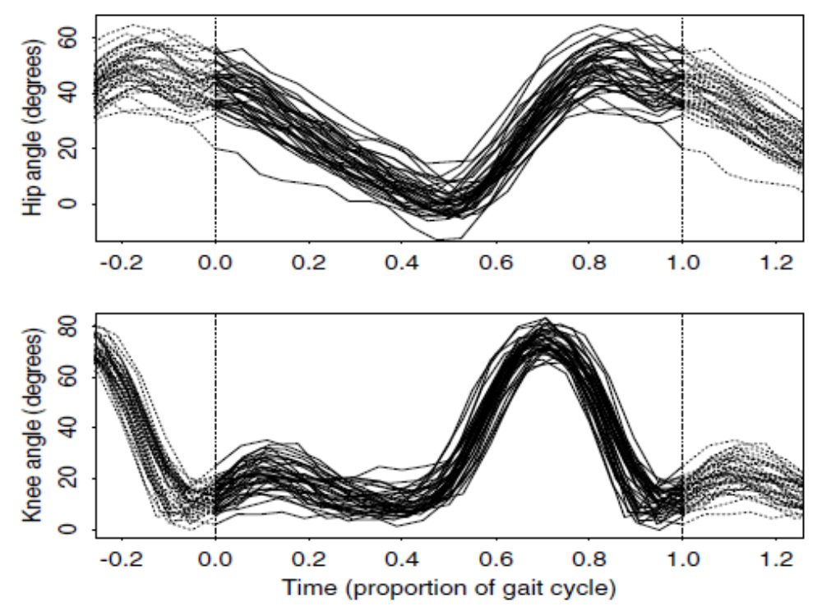
Data on How Children Walk
Both sets of functions are periodic and are plotted as dotted curves somewhat beyond the interval for clarity

Slide 22
Data on How Children Walk
We see that the knee shows a two-phase process, while the hip motion is single-phase.
It is harder to see how the two joints interact: The figure does not indicate which hip curve is paired with which knee curve.

Slide 23
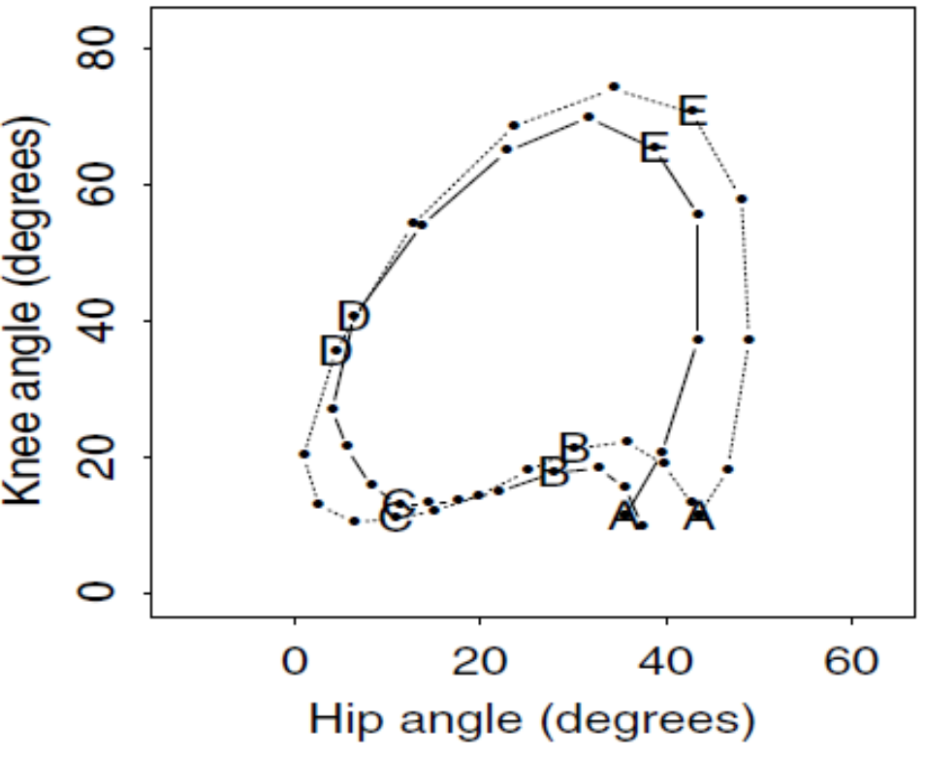
Data on How Children Walk
Solid line: The angles in the sagittal plane formed by the hip and knee for a single child plotted against each other.
Dotted line: The corresponding plot for the average across children. The points indicate 20 equally spaced time points in the gait cycle. The letters are plotted at intervals of one fifth of the cycle with A marking the heel strike

Slide 24
Data on How Children Walk
An interesting feature in the previous plot is the cusp occurring at the heel strike as the knee momentarily reverses its extension to absorb the shock.
The angular velocity is clearly visible in terms of the spacing between numbers, and it varies considerably as the cycle proceeds.
The child whose gait is represented by the solid curve differs from the average in two principal ways.

Slide 25
Data on How Children Walk
First, the portion of the gait pattern in the C–D part of the cycle shows an exaggeration of movement relative to the average.
Second, in the part of the cycle where the hip is most bent, this bend is markedly less than average; interestingly, this is not accompanied by any strong effect on the knee angle.
The overall shape of the cycle for this particular child is rather different from the average.

Slide 26
Functional Models for Nonfunctional Data
Nonparametric density estimation
Item response theory

Slide 27
The goals of functional data analysis
The goals of functional data analysis are essentially the same as those of any other branch of statistics.
They include the following aims:
  • to represent the data in ways that aid further analysis;
  • to display the data so as to highlight various characteristics;
  • to study important sources of pattern and variation among the data;
  • to explain variation in an outcome or dependent variable by using input or independent variable information;
  • to compare two or more sets of data with respect to certain types of variation, where two sets of data can contain different sets of replicates of the same functions, or different functions for a common set of replicates.

Slide 28
How is functional data analysis distinctive?
Conceptually, functional data are continuously defined.
  Of course, in practice they are usually observed at discrete points and also have to be stored in some finite-dimensional way within the computer, but this does not alter our underlying way of thinking.
The individual datum is the whole function, rather than its value at any particular point.
  The various functional data will often be independent of one another, but there are no particular assumptions about the independence of different values within the same functional datum.
In some cases the data are functions of time, but there is nothing special about time as a variable.
  In the examples we have been involved in, the data are functions of a one-dimensional variable, but most of the insights carry over straightforwardly to functions of higher-dimensional variables.

Slide 29
How is functional data analysis distinctive?
There is no general requirement that the data be smooth, but often smoothness or other regularity will be a key aspect of the analysis.
  In some cases, derivatives of the observed functions will be important.
  On other occasions, even though the data themselves need not be smooth, smoothness assumptions will be appropriate for mean functions or other functions involved in modeling the observed data.
Another way to characterize the strategy in a data analysis is as
  exploratory,
  confirmatory, or
  predictive

Slide 30
How is functional data analysis distinctive?
In exploratory mode, the questions put to the data tend to be rather open-ended in the sense that one expects the right technique to reveal new and interesting aspects of the data, as well as to shed light on known and obvious features.
Exploratory investigations tend to consider only the data at hand, with less concern for statements about larger issues such as characteristics of populations or events not observed in the data.

Slide 31
How is functional data analysis distinctive?
Confirmatory analyses, on the other hand, tend to be inferential and to be determined by specific questions about the data.
Some type of structure is assumed to be present in the data, and one wants to know whether certain specific statements or hypotheses can be considered confirmed by the data.

Slide 32
How is functional data analysis distinctive?
The dividing line between exploratory and confirmatory analyses tends to be the extent to which probability theory is used, in the sense that most confirmatory analyses are summarized by one or more probability statements.
Predictive studies are somewhat less common, and focus on using the data at hand to make a statement about unobserved states, such as the future.

Slide 33
First Steps in a Functional Data Analysis

Slide 34
Data Collection and Organization
We assume that there may be replications of each function, indexed by i = 1,..., N.
  Each replicate is referred to as an observation, since we want to treat the discrete values as a unitary whole.
As a rule functions of t are observed only at discrete sampling values t_{j} , j = 1,..., n, and these may or may not be equally spaced.
  But there may well be more than one function of t being observed, as would be the case for handwriting data, where there are X(t)-, Y (t)-, and possibly Z(t)-[or more] coordinate functions

Slide 35
Data Representation: Smoothing and Interpolation
The data are next converted to functional form: assuming that a functional datum for replication i arrives as a set of discrete measured values, y_{i1},…, y_{in}, the first task is to convert these values to a function x_{i} with values x_{i}(t) computable for any desired argument value t.
By this is meant that the raw data for observation i are used to define a function x_{i} that can be evaluated at all values of t over some interval.
  If the discrete values are assumed to be errorless, then the process is interpolation, but if they have some observational error that needs removing, then the conversion from discrete data to functions (which can theoretically be evaluated at an infinite number of points) may involve smoothing.

Slide 36
Data Representation: Smoothing and Interpolation
We usually want to declare that the underlying function x is smooth, so that a pair of adjacent data values, y_{j} and y_{j+1} are necessarily linked together to some extent and unlikely to be too different from each other.
If this smoothness property did not apply, there would be nothing much to be gained by treating the data as functional rather than just multivariate.
By smooth, we usually mean that function x possesses one or more derivatives, which we indicate by Dx, D²x, etc so that D^{m}x refers to the derivative of order m, and D^{m}x(t) is the value of that derivative at argument t.

Slide 37
Data Representation: Smoothing and Interpolation
Example (Smoothing): The gait data were converted to functions by the simplest of interpolation schemes: joining each pair of adjacent observations by a straight line segment.
This approach would be inadequate if we require derivative information.
However, one might perform a certain amount of smoothing while still respecting the periodicity of the data by fitting a Fourier series to each record: A constant plus three pairs of sine and cosine terms does a reasonable job for these data.

Slide 38
Data Representation: Smoothing and Interpolation
There are often conceptual constraints on the functions that we estimate.
Example : The growth data were smoothed using smoothing splines, and this more sophisticated technique also provides high quality derivative information.
  The growth curve fits should be strictly increasing, and we shall see that imposing this constraint results in a rather better estimate of the acceleration curves

Slide 39
The interplay between smooth and noisy variation
Smoothness, in the sense of possessing a certain number of derivatives, is a property of the latent function x, and may not be at all obvious in the raw data vector y = (y₁,..., y_{n}) owing to the presence of observational error or noise that is superimposed on the underlying signal by aspects of the measurement process.

Slide 40
The interplay between smooth and noisy variation
We express this in notation as
y_{j} = x(t_{j}) + ε_{j} ,
where the noise, disturbance, error, perturbation or otherwise exogenous term ε_{j} contributes a roughness to the raw data.
In representing the raw data as functions one task is to attempt to filter out this noise as efficiently as possible.

Slide 41
The interplay between smooth and noisy variation
However, in other cases we may pursue the alternative strategy of leaving the noise in the estimated function; and instead require smoothness of the results of our analysis, rather than of the data that are analyzed.
In vector notation we express the “signal plus noise” model as y = x(t) + e.

Slide 42
The interplay between smooth and noisy variation
The variance-covariance matrix for the vector of observed values y is equal to the variance-covariance matrix for the corresponding vector of residual values since the values x(t_{j}) are here considered fixed effects with variance 0.
Let Σ_{e} be our notation for residual variance-covariance matrix, which expresses how the residuals vary over repeated samples that are identical in every respect except for noise or error variation.

Slide 43
Data registration or feature alignment
The functions may also need to be registered or aligned, in order to have important features found in each curve occur at roughly the same argument values.
This process is said to separate vertical amplitude variation from horizontal or phase variation.
See Sec.1.5.2.

Slide 44
Data display
Different displays of data can bring out different features of interest, and that the standard plot of x(t) against t is not necessarily the most informative.

Slide 45
Plotting pairs of derivatives
Plotting the higher derivative against the lower is often more informative, partly because it is easier to detect departures from linearity than from other functional forms, and partly because the differentiation may expose effects not easily seen in the original functions
  See Section 1.5.4
The second derivative or acceleration on the vertical axis is plotted against the first derivative or velocity on the horizontal axis in what is called a phase plane plot.

Slide 46
Exploring variability in functional data

Slide 47
Functional descriptive statistics
Any data analysis begins with the basics: estimating means and standard deviations.
What is elementary for univariate and classic multivariate data turns out to be not always so simple for functional data.
  curve registration or feature alignment may have to be applied in order to separate amplitude variation from phase variation before these statistics are used.

Slide 48
Functional PCA
Most sets of data display a small number of dominant or substantial modes of variation, even after subtracting the mean function from each observation.
An approach to identifying and exploring these is to adapt the classic multivariate procedure of principal components analysis to functional data.

Slide 49
Other methods
Functional Canonical Correlation
Functional Linear Models
Principal differential analysis

Slide 50
Next Topic: Constructing functional data objects in R

